Slide 1

Concept of Operations Flow

Slide 2
RTB
Return to Base
Concept of Operations Flow
Pre Operations Phase
Operations Phase
Manufacturing/ Assembly
Implement nuclear and rechargeable battery
Charging
Integration of Components
Final Tests
Loading
Done by mechanical means.
Implementing universal attachment points
Allows for a 2-person lift if 200kg or less
Pre-Launch Assembly
Launch
Autonomous Roundtrip Travel
Sensors allow for autonomous independent navigation and travel
Allows for remote access
LV Separation
Unloading
Done by mechanical means.
Implementing universal attachment points
Allows for a 2-person lift if 200kg or less
Space Travel
Landing Sequence
Initial Setup

Slide 3
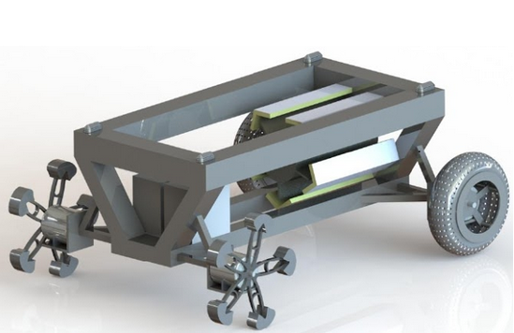
Body consisting of aerospace grade aluminum
Latching system
Nuclear reactor
Sensors, hardware, and battery
Motor
Wire mesh
Wheg

